Slide 1
Angular CLI
Tooling Features
Lecture 8
By James(Jin) Wang
09/28/2019

Slide 2
Outline
Updating Angular
Workspaces with multiple projects
Generating Angular Libraries
Adding Libraries to Angular
Angular Console

Slide 3
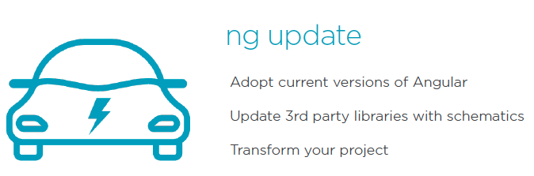
Updating Angular

Slide 4
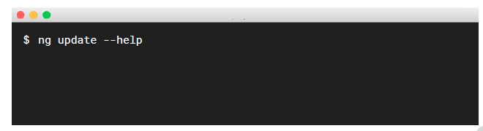
Updating Angular
  Getting Help:
  Add the --help or -h flag

Slide 5
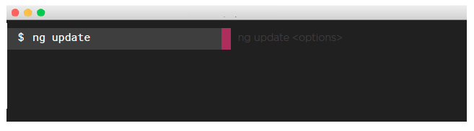
Updating Angular
  Update your Angular App:
  List the changes with ng update
  Update your project with ng update <package> <options>

Slide 6
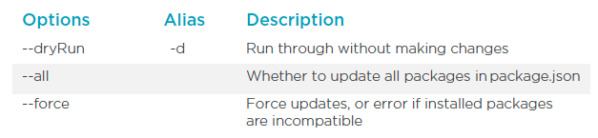
Updating Options
  Common ng update Options:

Slide 7
Demo
  update.angular.io
  ng update
  ng update @angular/cli
  ng update @angular/core
  ng update @angular/material

Slide 8
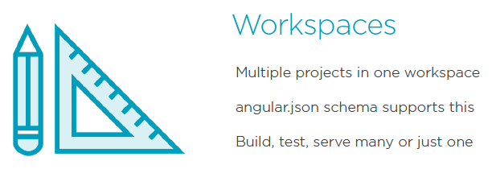
Multiple Projects

Slide 9
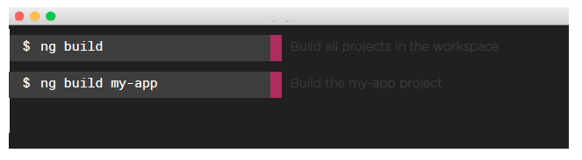
Multiple Projects
  Targetting your workspace:
  Target the workspace you want to affect with ng build <project>
  Other commands support targets ng <command> <project>
  - ng build, ng serve, ng test, ng e2e

Slide 10
Demo
  ng test --code-coverage
  ng test

Slide 11
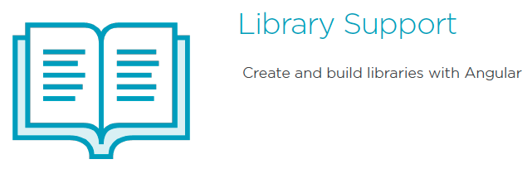
Generating Libraries

Slide 12
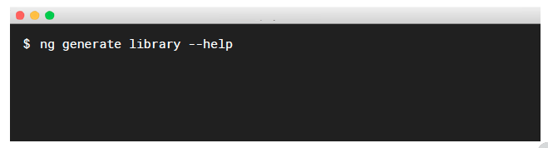
Generating Libraries
  Getting Help:
  Add the --help flag

Slide 13
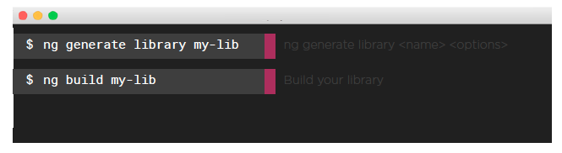
Generating Libraries
  Generate your Angular Library:
  Create with ng generate library <name> <options>
  CLI updates your tsconfig to look for your library reference
  Must build your library for your app to see it

Slide 14
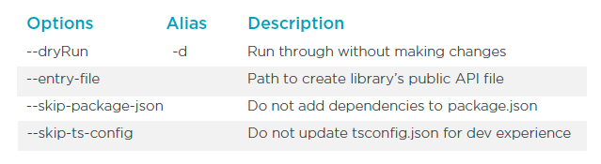
Generating Libraries
  Common ng generate library Options:

Slide 15
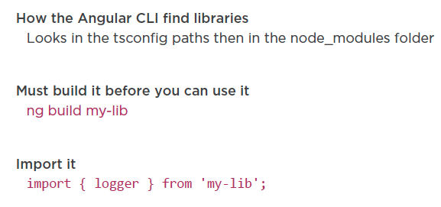
Generating Libraries
  Using your Library:

Slide 16
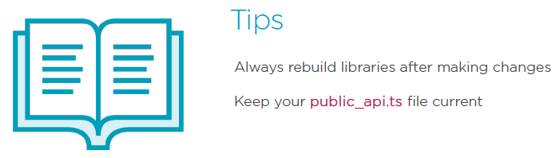
Generating Libraries

Slide 17
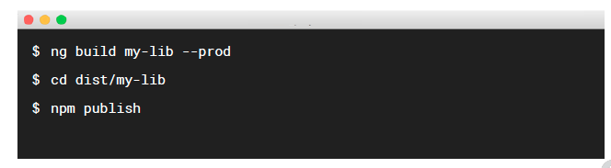
Generating Libraries
  Publishing your Library:
  Build your library for production
  Publish to npm

Slide 18
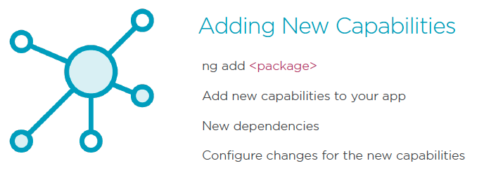
Adding to Angular

Slide 19
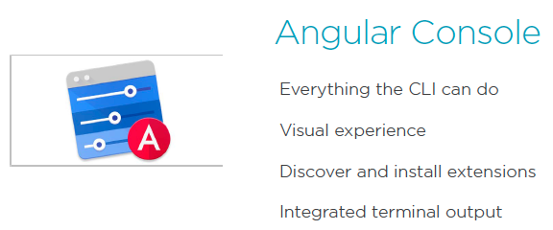
Angular Console

Slide 20
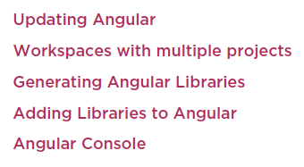
Summary

